Slide 1


On Stability of Deep Neural Network-Based Models
SIAM Annual Meeting, 22nd of July 2021
Jan Drgona (PNNL), Sayak Mukherjee (PNNL),
Jiaxin Zhang (ORNL), Frank Liu (ORNL),
Mahantesh Halappanavar (PNNL)
Collaborators: Aaron Tuor, Soumya Vasisht,
Elliott Skomski, Draguna Vrabie (PNNL)

Slide 2

Stability Analysis of Deep Neural Network Models
Motivation
Safety-critical and high-performance systems call for formal verification methods to ensure safe operation.
Lack of guarantees on global and local behavior of DNNs still remain limiting factors.
Properties like stability and robustness are crucial for reliable modeling and control.
Objectives
Stability analysis and sufficient conditions for stability of deep neural networks.
Approaches
Apply system- and control-theoretic analysis methods on DNNs.

Slide 3
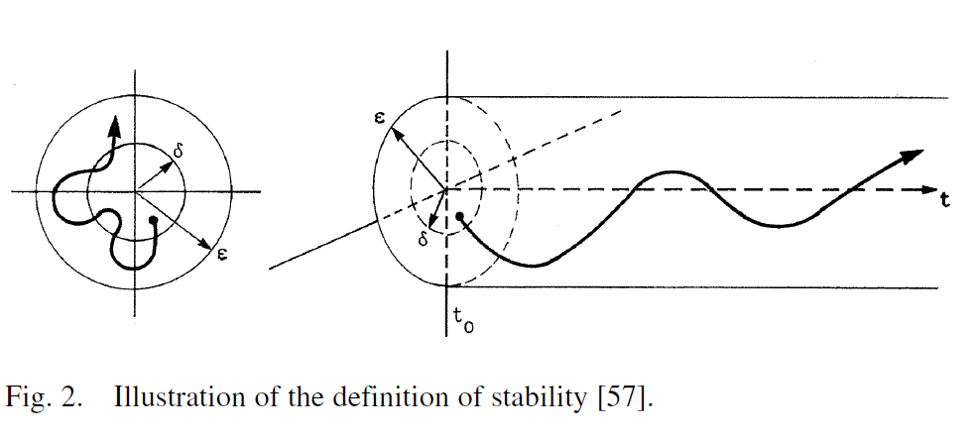
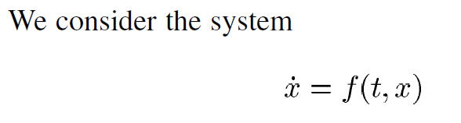
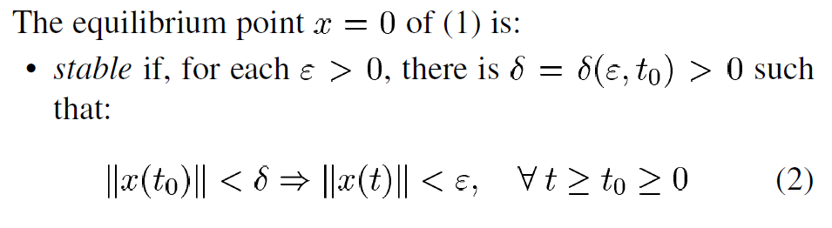
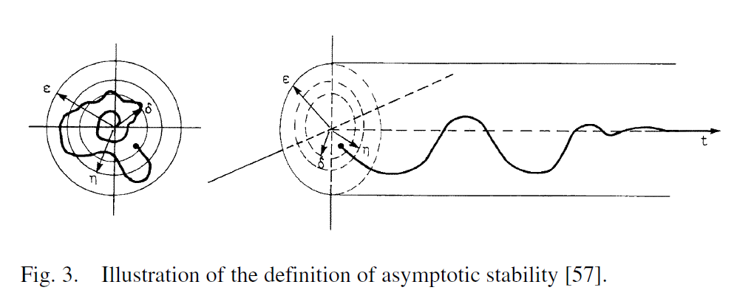
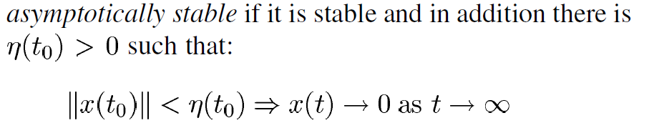
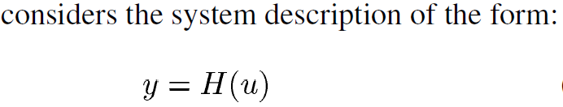
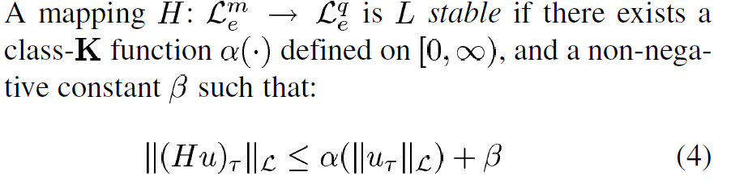
Stability of Dynamical Systems
P. Kundur et al., "Definition and classification of power system stability," in IEEE Transactions on Power Systems, 2004.

Slide 4
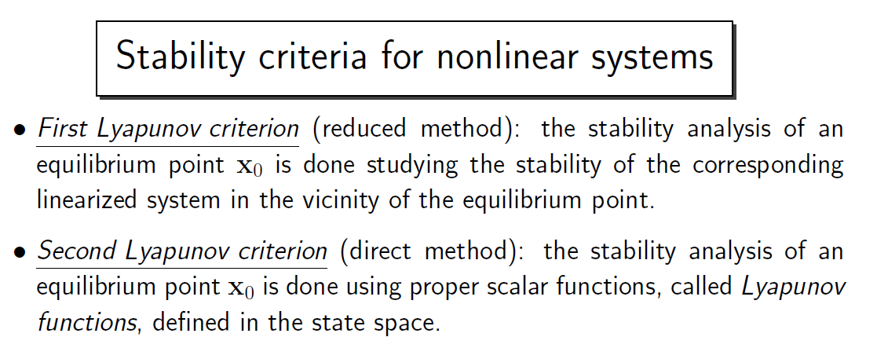
Stability Criteria
Zanasi Roberto – Lecture notes on System Theory.

Slide 5
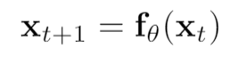
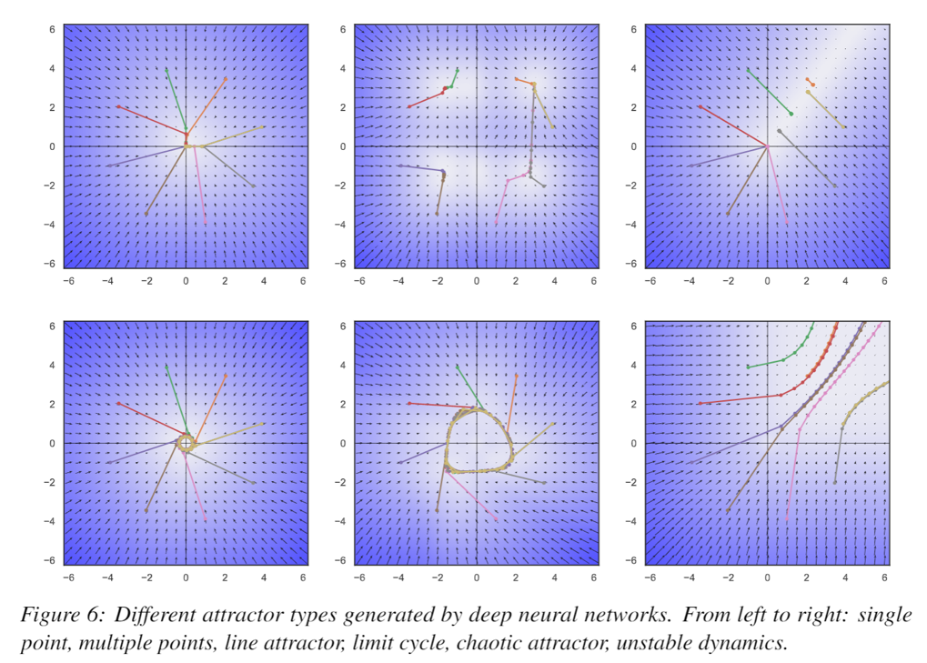
Stability Analysis of Neural Dynamics
Exploring connections between:
Deep neural networks (DNNs)
Piecewise affine (PWA) maps
Contraction of PWA maps and DNNs
Banach fixed point theorem
2D attractors generated by deep neural networks.
Jan Drgona, Aaron Tuor, Soumya Vasisht, Elliott Skomski, Draguna Vrabie, Spectral Analysis and Stability of Deep Neural Dynamics, arXiv:2011.13492

Slide 6
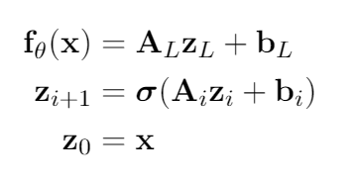
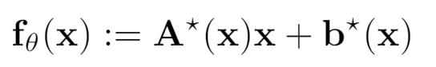

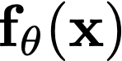


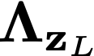
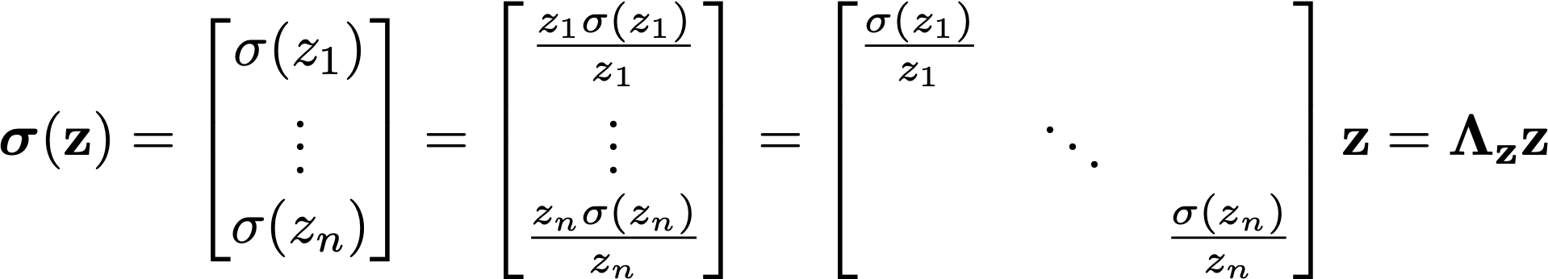
Deep Neural Networks as Piecewise Affine Maps
Deep neural network
PWA map
At every point , the neural network, without bias may be represented as
where represent the weight parameterizations at layer , and is a diagonal matrix that represents the element-wise application of the nonlinear activation function at layer .
Jan Drgona, Aaron Tuor, Soumya Vasisht, Elliott Skomski, Draguna Vrabie, Spectral Analysis and Stability of Deep Neural Dynamics, arXiv:2011.13492
Notes:
The presentation I’m giving today is for a data-driven method for dynamics modeling.
We should care about this because people interact with and depend on complicated systems all the time.
Greater understanding of these systems can lead to outcomes which are
More energy efficient
Cost effective
Conducive to human life
Having an accurate model of a system enables scientific discovery,
Can provide critical information to support high stakes decisions in changing environments
Or to provide necessary information for predictive maintenance of high value equipment, avoiding costly and potentially dangerous equipment
Failures.
One of the most common and lucrative uses of systems models are for predictive control in manufacturing and other large scale enterprises.
I’m presenting a method today which bridges benefits of traditional physics-based modeling with more recent data-driven modeling using deep learning
Traditional physics-based modeling works very well and is widely used in many real world applications. However, it can’t always be applied to every situation.
missing information
incomplete awareness of the model state space.
limitations on the available operational data.
For large scale systems, not only are they difficult to model from first principles, it is also not always possible to simulate the system in real time.
Data-driven approaches for systems modeling are an alternative in these situations but can come with their own disadvantages.
Can take a lot of data to train and may behave unpredictably outside the distribution of training data in unobserved regions of the system state space.
In addition, modern neural network approaches don’t typically provide constraints enforcement within physically realizable and operationally safe bounds,

Slide 7
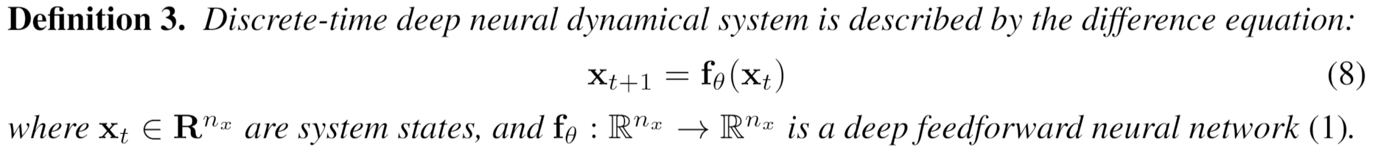
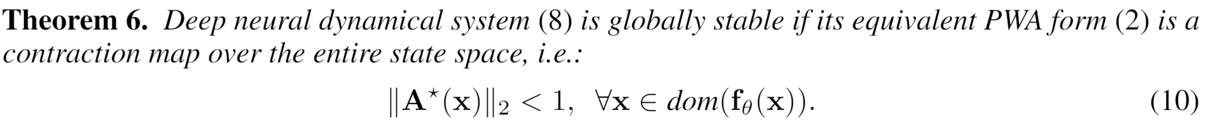
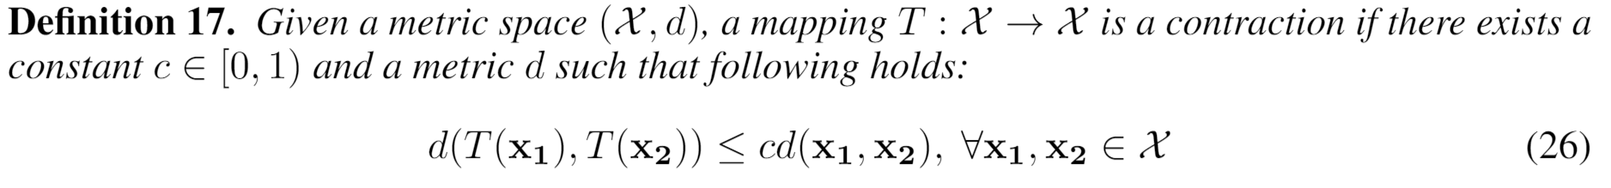
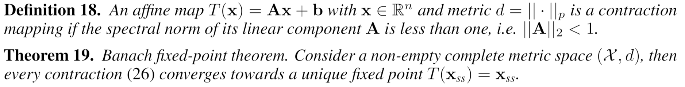
Stability Conditions of Deep Neural Dynamics
Jan Drgona, Aaron Tuor, Soumya Vasisht, Elliott Skomski, Draguna Vrabie, Spectral Analysis and Stability of Deep Neural Dynamics, arXiv:2011.13492
Notes:
The presentation I’m giving today is for a data-driven method for dynamics modeling.
We should care about this because people interact with and depend on complicated systems all the time.
Greater understanding of these systems can lead to outcomes which are
More energy efficient
Cost effective
Conducive to human life
Having an accurate model of a system enables scientific discovery,
Can provide critical information to support high stakes decisions in changing environments
Or to provide necessary information for predictive maintenance of high value equipment, avoiding costly and potentially dangerous equipment
Failures.
One of the most common and lucrative uses of systems models are for predictive control in manufacturing and other large scale enterprises.
I’m presenting a method today which bridges benefits of traditional physics-based modeling with more recent data-driven modeling using deep learning
Traditional physics-based modeling works very well and is widely used in many real world applications. However, it can’t always be applied to every situation.
missing information
incomplete awareness of the model state space.
limitations on the available operational data.
For large scale systems, not only are they difficult to model from first principles, it is also not always possible to simulate the system in real time.
Data-driven approaches for systems modeling are an alternative in these situations but can come with their own disadvantages.
Can take a lot of data to train and may behave unpredictably outside the distribution of training data in unobserved regions of the system state space.
In addition, modern neural network approaches don’t typically provide constraints enforcement within physically realizable and operationally safe bounds,

Slide 8
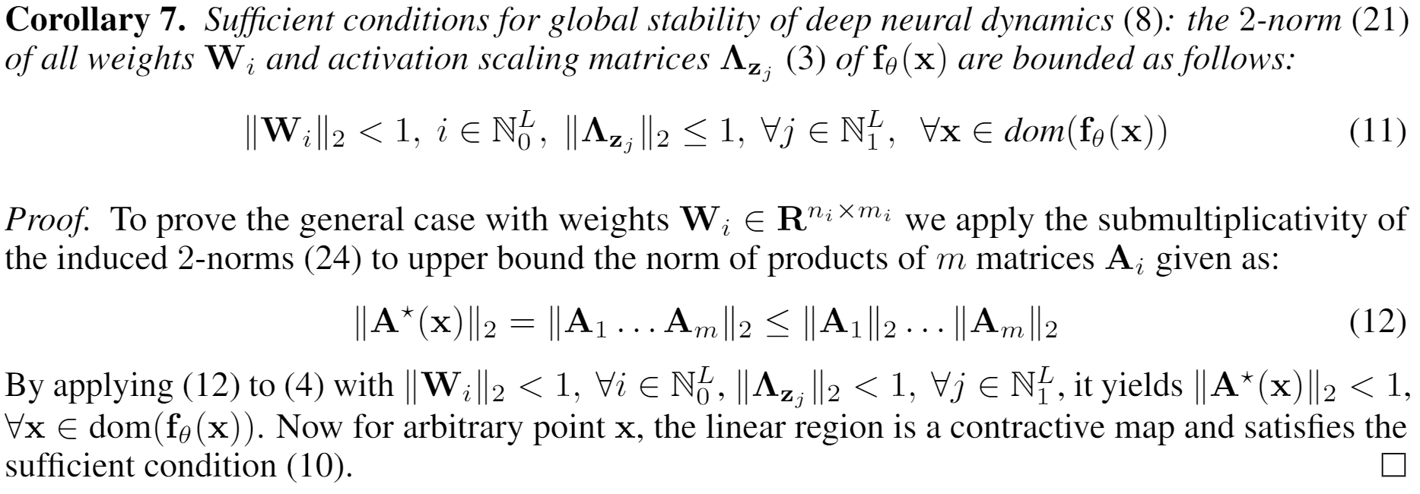
Dynamical Effects of Weights and Activations
Jan Drgona, Aaron Tuor, Soumya Vasisht, Elliott Skomski, Draguna Vrabie, Spectral Analysis and Stability of Deep Neural Dynamics, arXiv:2011.13492

Slide 9
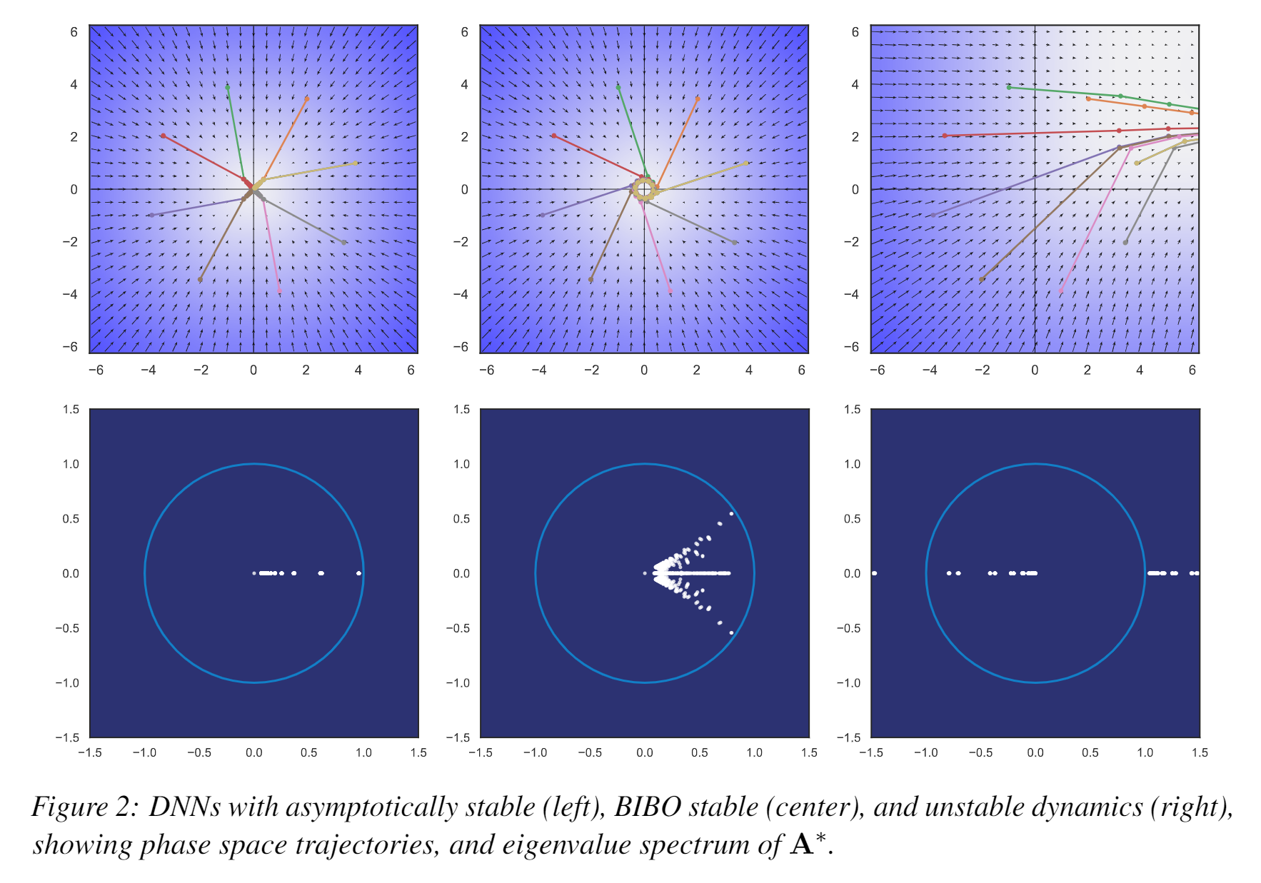
Dynamical Effects of Weights
Jan Drgona, Aaron Tuor, Soumya Vasisht, Elliott Skomski, Draguna Vrabie, Spectral Analysis and Stability of Deep Neural Dynamics, arXiv:2011.13492

Slide 10
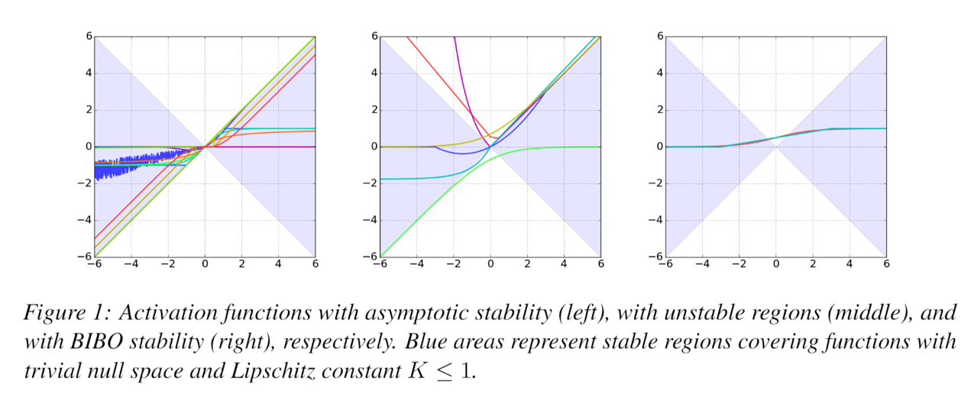
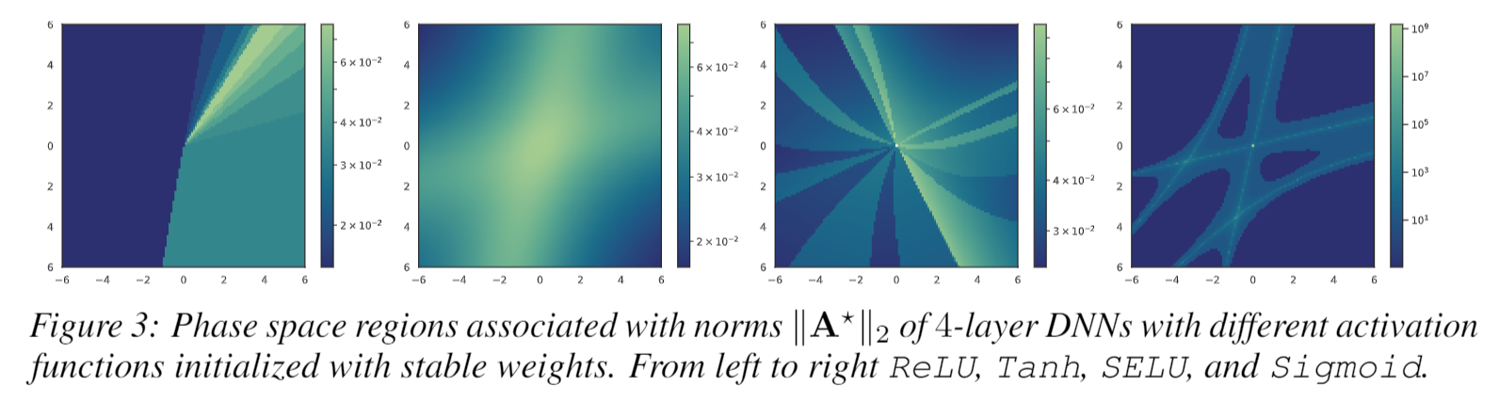
Dynamical Effects of Activation Functions
Jan Drgona, Aaron Tuor, Soumya Vasisht, Elliott Skomski, Draguna Vrabie, Spectral Analysis and Stability of Deep Neural Dynamics, arXiv:2011.13492

Slide 11
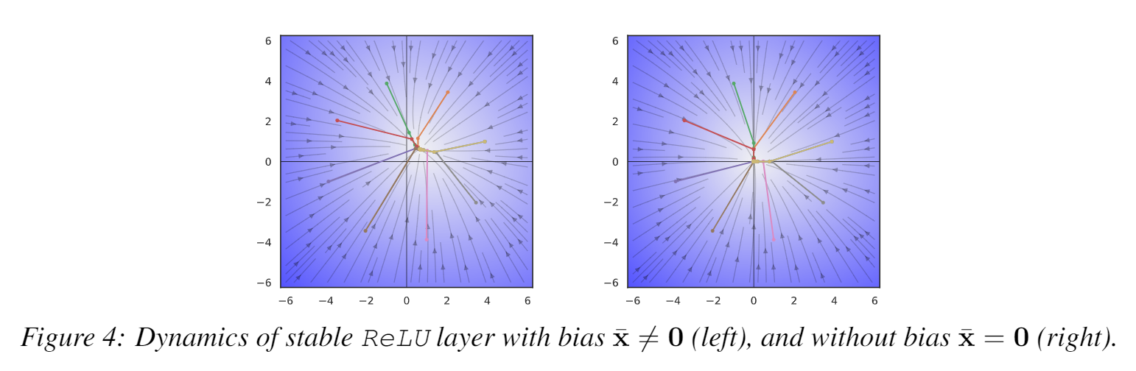
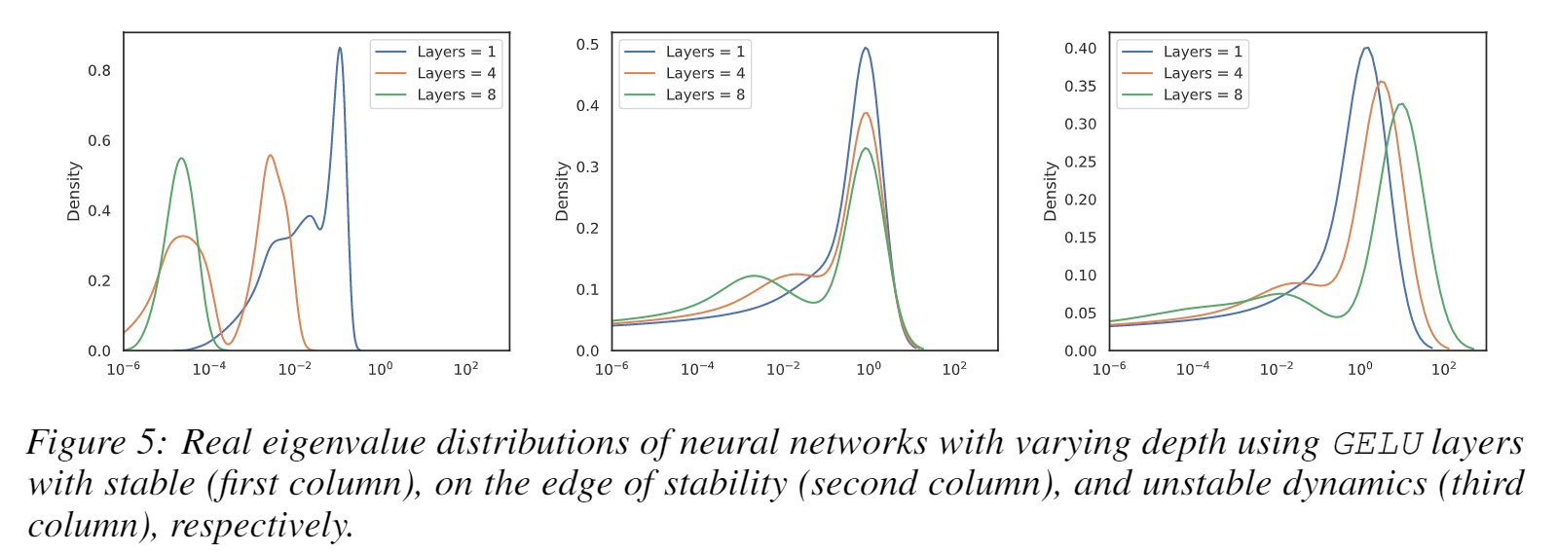
Dynamical Effects of Biases and Depth
Jan Drgona, Aaron Tuor, Soumya Vasisht, Elliott Skomski, Draguna Vrabie, Spectral Analysis and Stability of Deep Neural Dynamics, arXiv:2011.13492

Slide 12
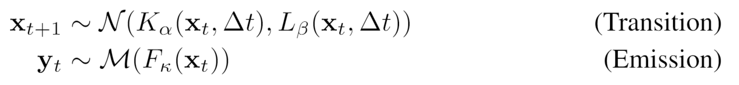
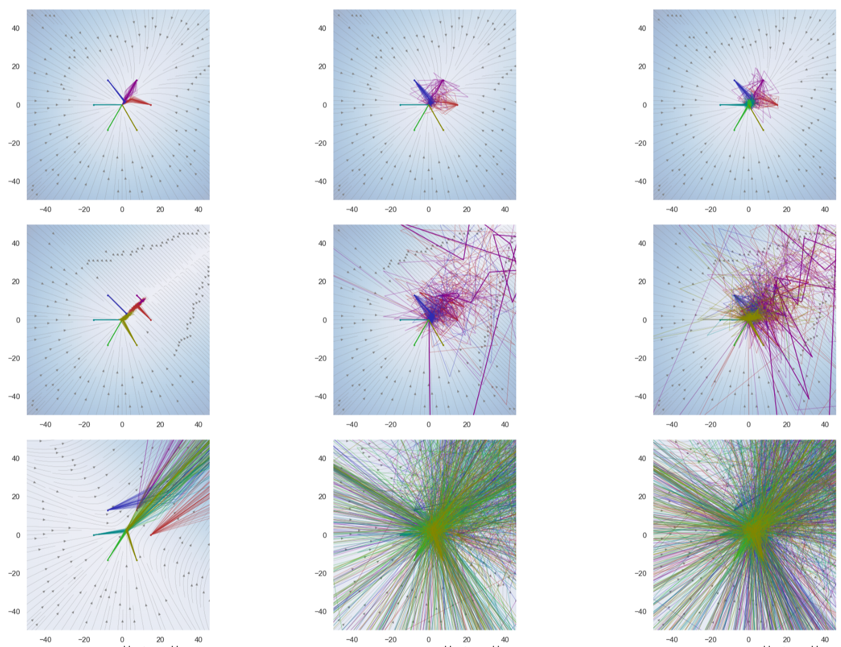
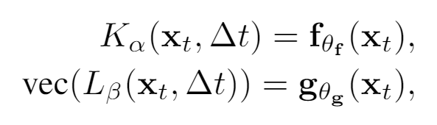
Stochastic Stability of Deep Markov Models
Exploring connections between:
Stability of stochastic systems
Deep neural networks (DNNs)
Deep Markov models (DMMs)
Contraction of DMMs
Banach fixed point theorem
2D attractors generated by deep Markov models.

Slide 13
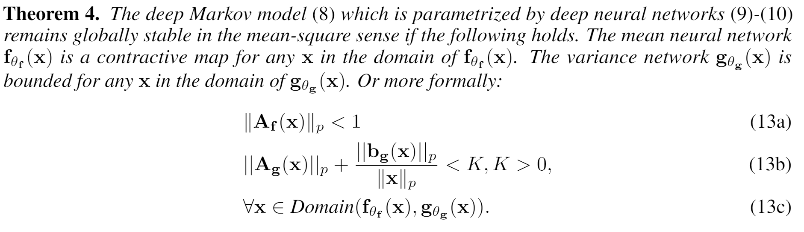
Stochastic Stability Conditions for Deep Markov Models

Slide 14
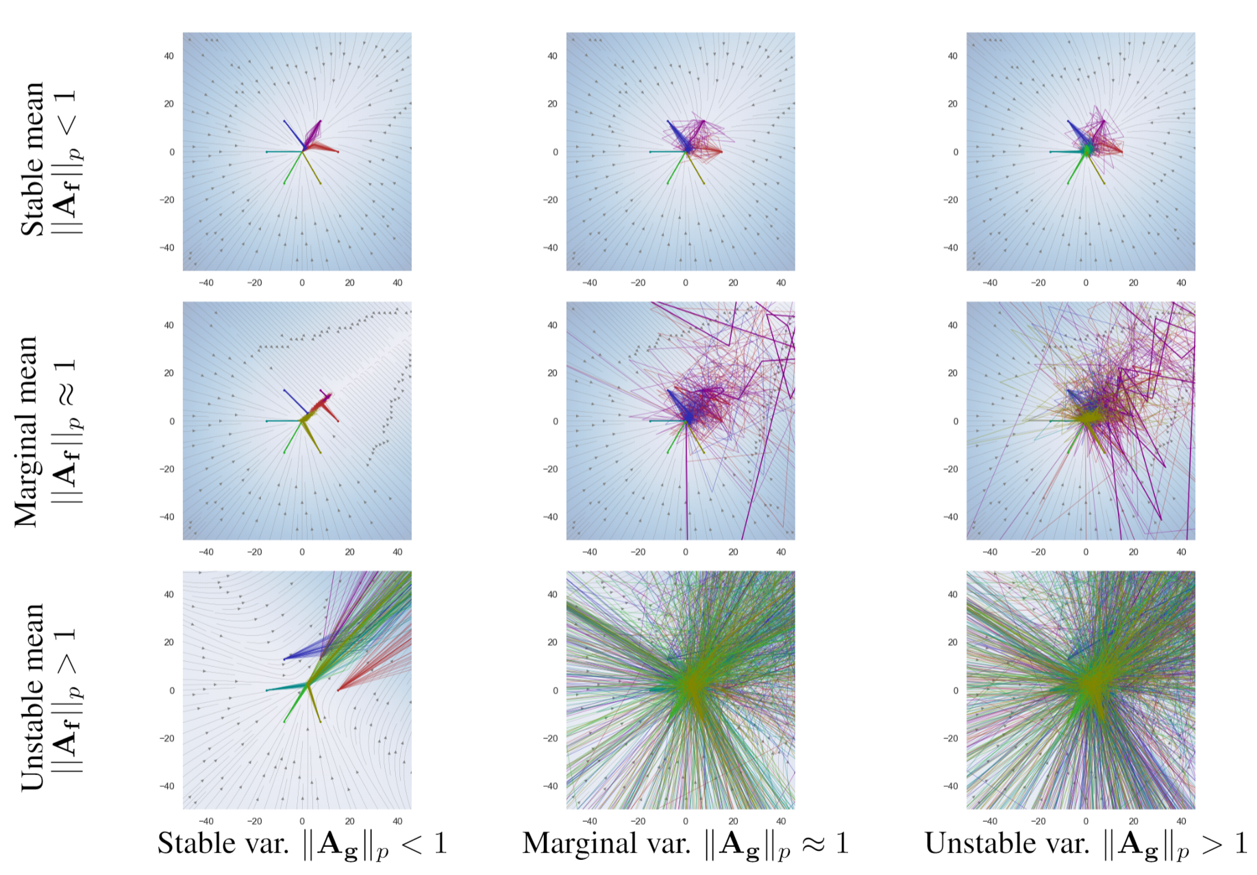
Effect of Mean and Variance on Stochastic Stability of Deep Markov Models

Slide 15
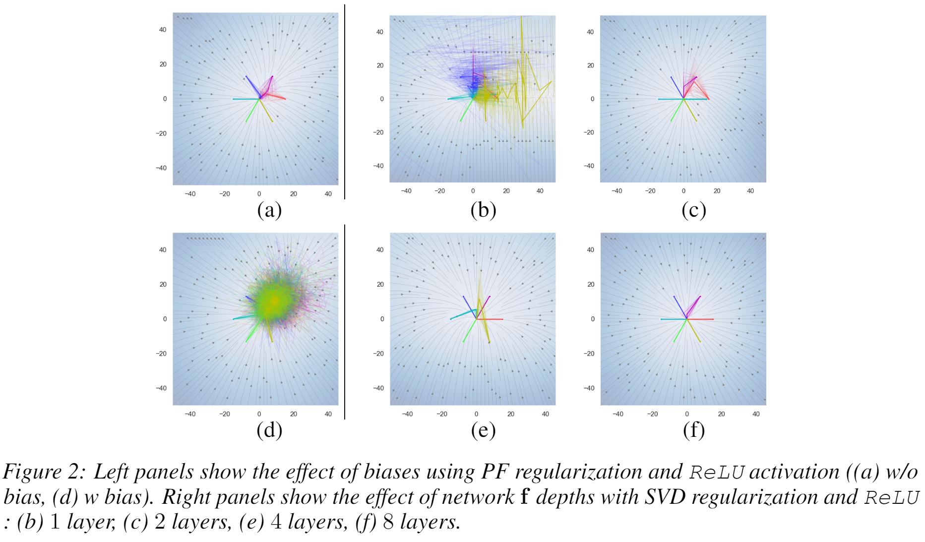
Effect of Biases and Depth on the Stability of Deep Markov Models

Slide 16
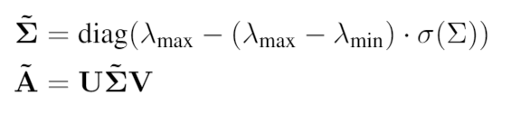
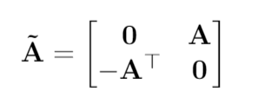
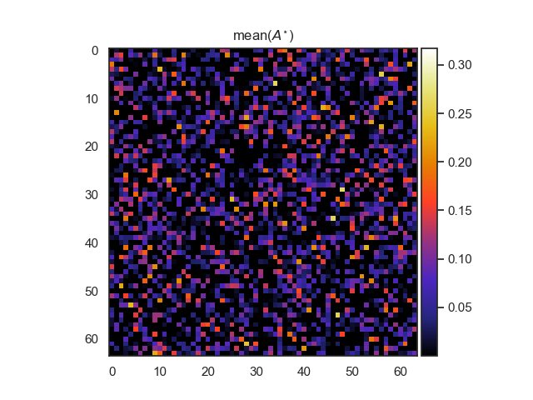
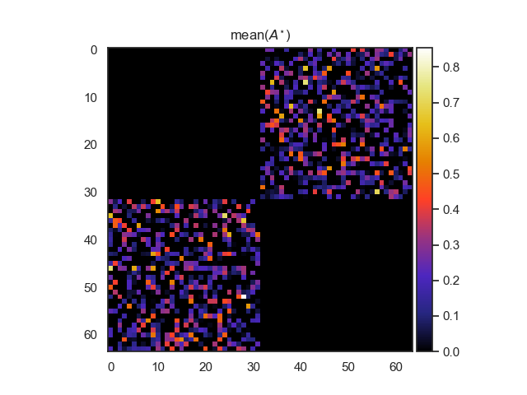
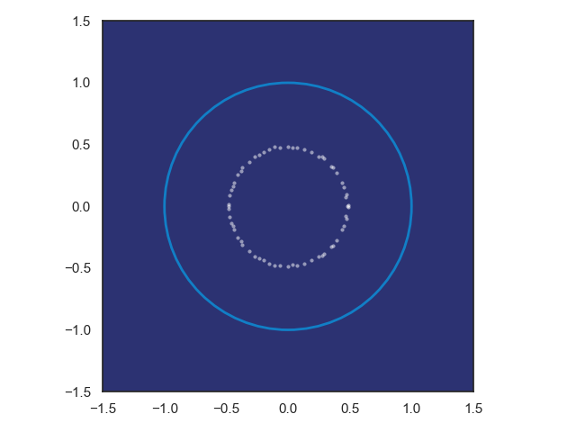
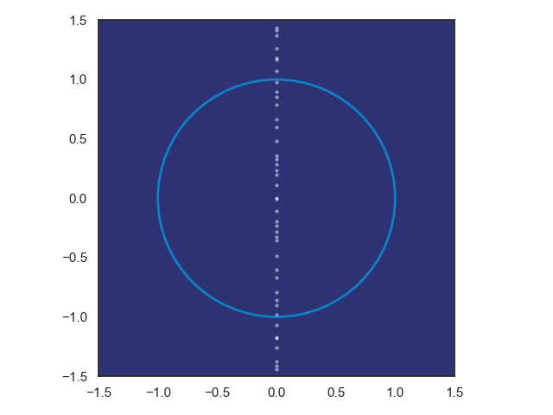
Practical Stability Constraints for DNN and DMM
SVD factorization
Hamiltonian weight
Pytorch implementation: https://github.com/pnnl/slim
[1] Jan Drgona, Aaron Tuor, Soumya Vasisht, Elliott Skomski, Draguna Vrabie, Spectral Analysis and Stability of Deep Neural Dynamics, arXiv:2011.13492, 2020 [2] Jiong Zhang, et al., Stabilizing Gradients for Deep Neural Networks via Efficient SVD Parameterization, 2018. [3] Eldad Haber and Lars Ruthotto, Stable Architectures for Deep Neural Networks 2017

Slide 17
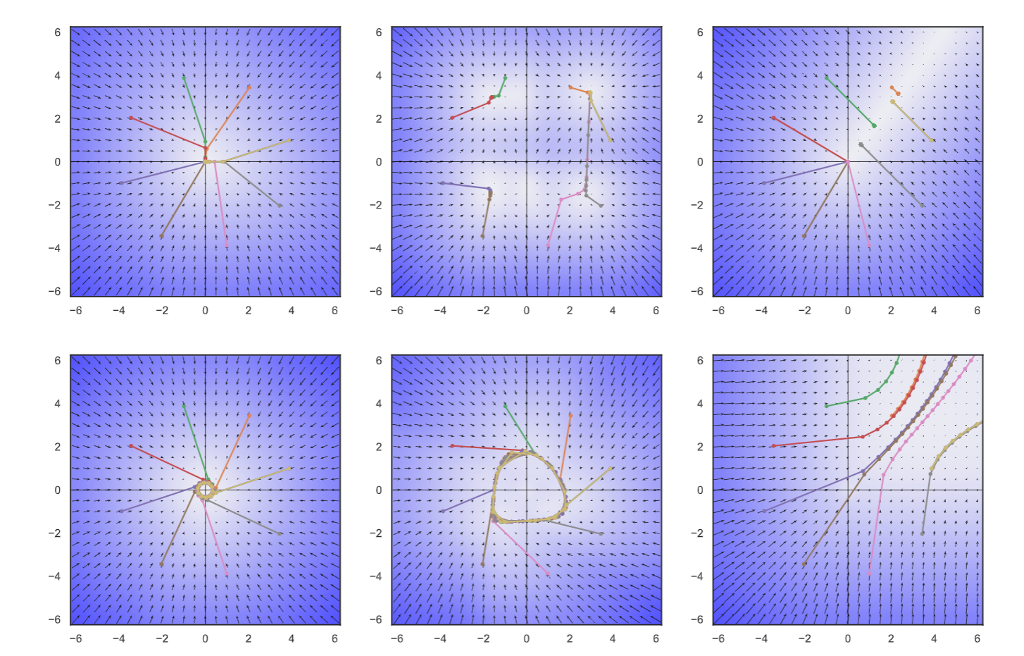
Conclusion
Stability of Neural Models
Piecewise affine (PWA) maps
Deep neural networks (DNNs)
Deep Markov models (DMMs)
Contraction of PWA maps, DNNs, and DMMs
Banach fixed point theorem
Ongoing Work
Stability of Normalizing Flows
Stability of Graph Neural Networks
Stability Constraints Implementation
Structured linear maps in Pytorch
https://pnnl.github.io/slim/
Contact
jan.drgona@pnnl.gov
https://www.linkedin.com/in/drgona/

